Slide 1
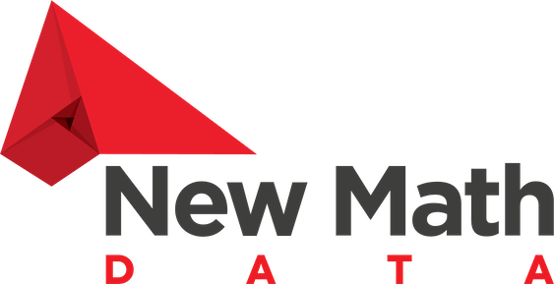
New Math Data, LLC.
Right decisions.
Lean architecture.
Faster to production.

Slide 2
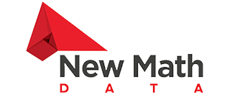
Who We Are.
Founded in 2018
New Math Data was founded in 2018 to help a few clients with their Cloud needs and then evolved into analyzing and forecasting massive data sets for the Power Industry, moving on to Onica, an AWS premier partner. Since then, New Math Data have formed a reliable and dedicated team of Solutions Architects and Engineers, which has proudly collaborated with numerous amazing customers helping them build a strong AWS footprint.
Right decisions. Lean architecture. Faster to production.

Slide 3
Story
30
30 years of Tech Industry Experience (just for the founders)
Superpowers: AI, ML, MLOps, DataOps, Data Engineering, DataBricks
All in on AWS
Headquartered in Houston, Texas
Traey Hatch
Co-Founder
Chris King
Solutions Architect

Slide 4
Passionate About Data
Stable Teams
By maintaining stable teams, we ensure consistent performance, reduced turnover, and a deep understanding of our clients’ needs, ultimately leading to superior outcomes.
Fast Team Set Up
Time is of the essence, and our streamlined and efficient team setup process ensures we hit the ground running.
Expert-Level Team Members
With a proven track record of delivering exceptional results, our teams leverage their expertise to tackle complex challenges head-on and consistently exceed client expectations.
Flexibility And Easy Scaling
Our agile approach empowers us with the flexibility to adapt swiftly to changing project requirements and market dynamics.

Slide 5
GenAI projects
GenAI Work
Categories
Generation
Summarization
Entity and Relationship Extraction
ChatBots

Slide 6
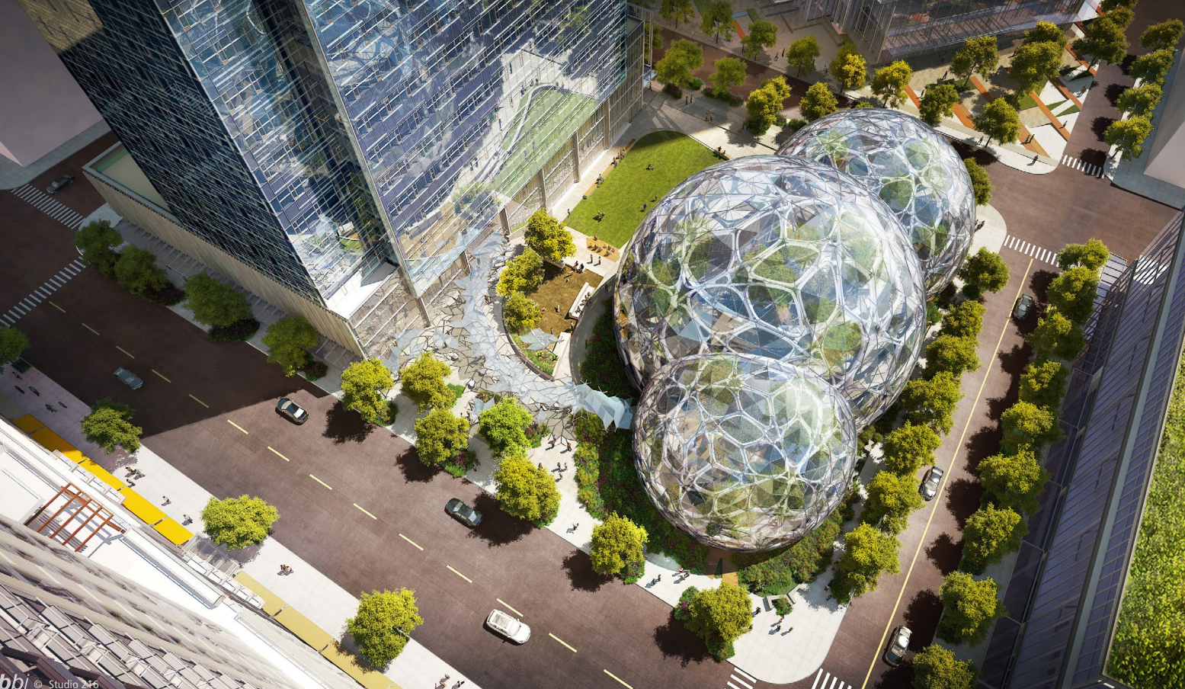
New Math Data GenAI Expo 2024
NYC, NY - SA Day, Feb 8th, 2024
Seattle, WA - SKO, Feb 28th, 2024
As an AWS Advanced Tier Partner, New Math Data is excited to bring a broad GenAI story across North America in 2024.

Slide 7
GenAI projects
ChatBots
Value Proposition
Quickly automate vast majority of customer interactions while ensuring high quality, detailed information, and a friendly tone
Gain valuable insights from chatbot metrics to drive improvements
Predefined workflows provide business rules and establish guardrails for bot interactions
Data insight for non-technical users
Serverless search services allow for quick prototyping, cost effective early use
Drive Bedrock, Kendra or OpenSearch adoption & usage

Slide 8
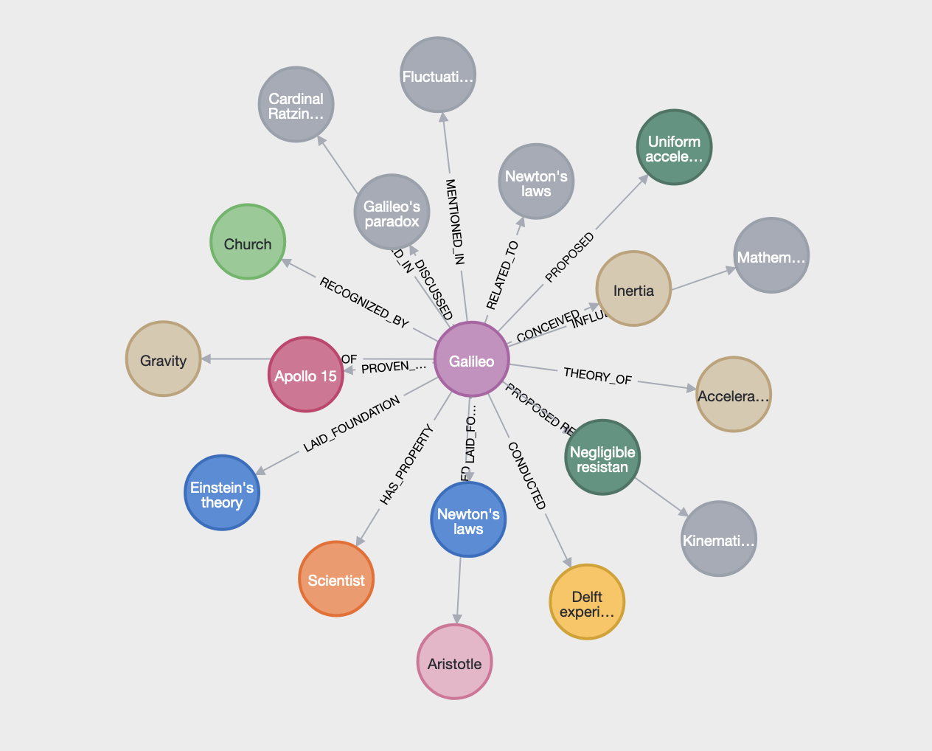
GenAI projects
Entity Extraction
LLM’s & Graph Databases
Galileo studied speed and velocity, gravity and free fall, the principle of relativity, inertia, projectile motion and also worked in applied science and technology, describing the properties of pendulums and "hydrostatic balances". He invented the thermoscope and various military compasses, and used the telescope for scientific observations of celestial objects. His contributions to observational astronomy include telescopic confirmation of the phases of Venus, observation of the four largest satellites of Jupiter, observation of Saturn's rings, and analysis of lunar craters and sunspots.
Graph databases excel at representing entities and relationships using nodes and edges
LLM’s can be primed and prompted to extract these entities and relationships and write the output to a graph database
Graph databases can represent this data via knowledge graphs
Knowledge graphs can:
Represent entity/relationships visually for serendipitous discovery
Be queried
Via OpenCypher/CQL
Interacted with programmatically via API’s

Slide 9
GenAI projects
Entity Extraction
Knowledge Graphs with LLMs
Parse the unstructured text into chunks
Extract the entities and relationships from the summarized text
Write the entities and relationships to the database
Provide the db schema to an app to answer the given question
Query the database for relevant nodes
Respond with a well formatted answer

Slide 10
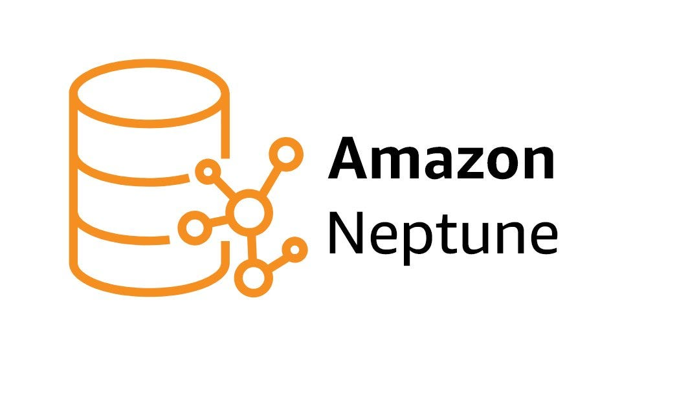
GenAI projects
Entity Extraction
LLM’s & Knowledge Graphs: Value Proposition
Customer has wealth of currently unusable natural language documents
Derive value
Integrate/incorporate into existing information systems and automated processes
Drive Amazon Neptune adoption & usage
NMD expertise
DAPP approved
Prototyping/POC
Production implementations

Slide 11
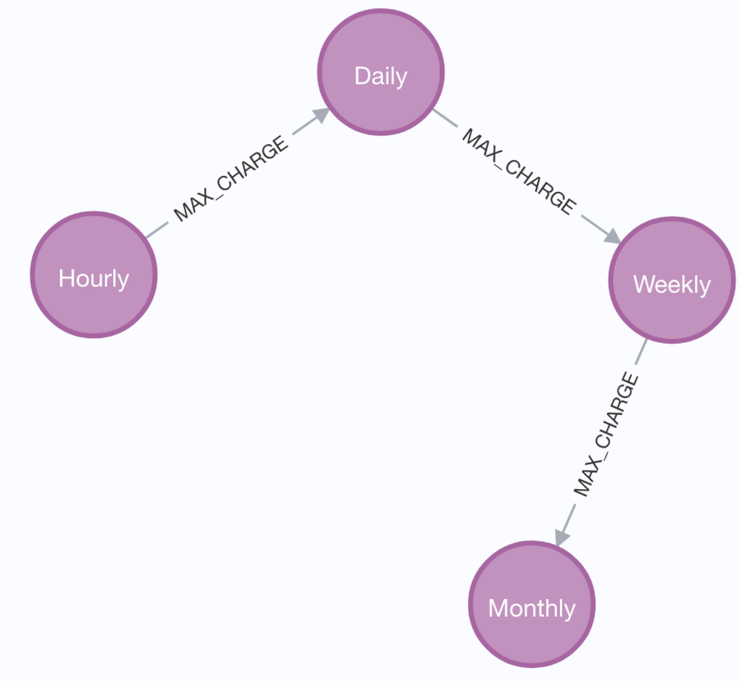
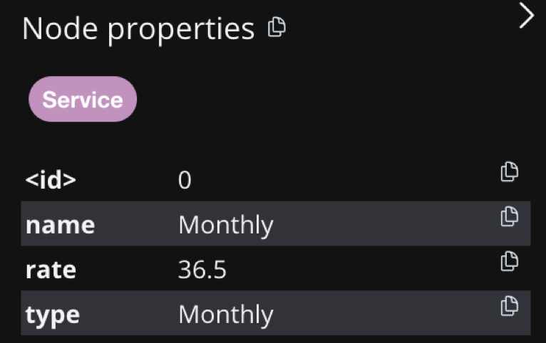
GenAI projects
Entity Extraction
Legal Text Parsing
For Point-to-Point service reserved for an Annual Period or a Monthly Period,
the charge for service supplied in a Monthly Period shall not exceed the Transmission Customers Monthly Period transmission reservation multiplied by $36.50 per MW-month. For a Network Integration Transmission Service Customer, the charge for service supplied in a month shall be the Customers load coincident with the hour of the DEP monthly Transmission System Peak during the month, multiplied by $36.50 per MW.

Slide 12
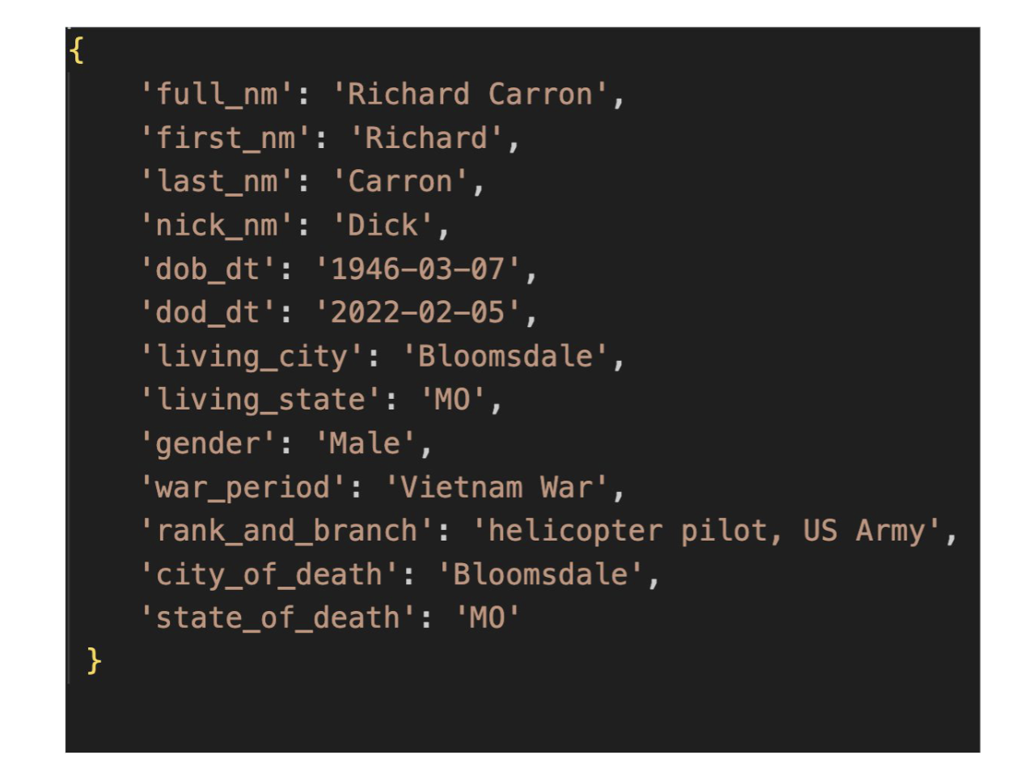
GenAI projects
Entity Extraction
LLM’s & Knowledge Graphs
LLM’s and Knowledge Graphs together can unlock a wealth of previously accessible data<=>wisdom
Use cases:
Obituary analysis for fraud prevention
Tariff analysis for energy sector
Cyber Threat Intelligence report analysis for cyber security

Slide 13
CV Bot
Live Demo
Came out of an internal hackathon
Up and running in customer account in less than 2 weeks
Customizable UI options (Slack, ChainLit)
Low cost (serverless)

Slide 14
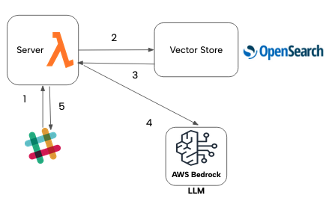
GenAI projects
Live Demo
Chatbots with RAG
User makes a request to the server with a question
Lambda vectorizes the question
Lambda fetches relevant docs using the Vector Store top 5 vectors
Lambda prompts the LLM with the user’s question and related vectors
Lambda sends formatted response from Model back to Slack and the user

Slide 15
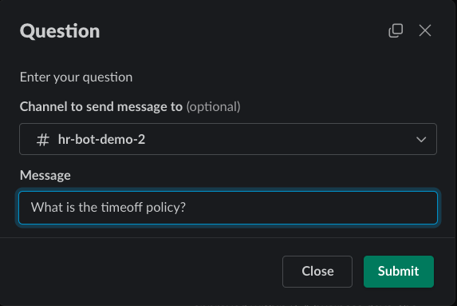
GenAI projects
Live Demo
CV Bot

Slide 16
Apogee ChatBot Demo
Live Demo
Runs on DataBricks with AWS Backend (S3, BedRock)
Answers questions with data from delta lake warehouse
Uses LangChain agents
Easy to deploy (runs on ECS)

Slide 17
GenAI projects
Live Demo
Agents
5-20x more LLM calls than with simple completion alone
User makes a request to the bot with a question
Agent prompts LLM to generate queries to answer question
Agent works with LLM to refine approach and find an answer
Agent retrieves data and asks LLM to format the response
Agent sends formatted response back to user

Slide 18
Agents versus single completion
Live Demo
Agents
Single completion
Use more tokens/api requests
Delivers more accurate, refined responses
Takes longer (1 minute or more)
Use less tokens and requests
Suitable for simple tasks where accuracy is less important
Really fast (~5 seconds per completion)

Slide 19
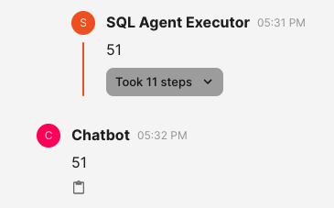
Apogee ChatBot Demo
Live Demo

Slide 20
Ask us about workshops!
Elevate your team's understanding of generative AI.
Dive deeper into practical applications tailored to your industry.
Hands-on exercises to reinforce learning.
Customized workshops to fit your team's schedule and objectives.
Unlock the full potential of generative AI for your business.
Schedule a consultation to learn more about our workshop offerings.

Slide 21
Thank you.
We hope to be of help to your business.
Contact Us
Phone: +1 (281) 817 - 6190
Email: info@newmathdata.com
NewMathData.com

